Slide 1


Multinomial models
The ordered logit model

Slide 2
28/05/2026
Data types and model selection
Multinomial
Multinominal logit regression
In some cases, this framework is unsuitable, requiring the use of alternative methods
Ordered
Ordered logit regression
Categorical
Binary
Logit/probit regression
Linear probability
Numerical
Time to event
Cox proportional hazards model
Outcome variable
Continuous
Linear regression
Objective
Data structure
Count
Poisson regression
Covariates
Negative binomial regression
Proportion
Beta regression
Cross section
Time series
Panel
Repeated cross section
Data analysis

Slide 3
28/05/2026
Categorical dependent variables with multiple categories
So far, we have studied situations where the dependent variable is either continuous or binary.
Continuous dependent variables ⟩ Simple linear regression approaches
Binary dependent variables ⟩ Linear probability models and logistic (logit) models.
In many cases the variable of interest can take more than two values:
1.
Nominal categorical dependent variables
In the case of logit models, we looked at scenarios where the dependent variable takes two values:
Employed (Y = 1) or unemployed (Y = 0)
Participation in elections (Y = 1) or non‑participation (Y = 0)
2.
Ordinal categorical dependent variables

Slide 4
28/05/2026
Ordinal regression
1.
Treat the dependent variable as if it were continuous
3.
Treat the dependent variable as ordinal
In this case, linear regression methods (OLS) can be used. This approximation depends on the number of categories in the dependent variable.
We assume that the variable is measured on an ordinal scale, even if the scale is a rough measurement of an underlying interval or ratio scale.
For example, the categories:
High
Medium
Low
Could be seen as approximations of socioeconomic status or intelligence.
2.
Ignore the ordinality of the dependent variable and treat it as nominal
Here, multinomial logistic models can be used. In doing so:
It discards part of the information available in the ordering
It is possible that more parameters than necessary are estimated.
It increases the risk of obtaining non‑significant statistical results.

Slide 5
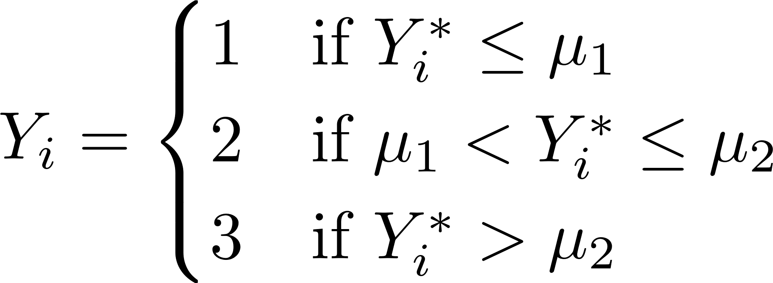
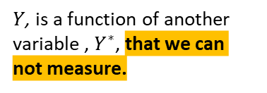

28/05/2026
Ordinal regression
Proportional Odds models
1.
We observe an ordinal variable $Y$
2.1.
We assume that the observed ordinal outcome Y is a function of another variable Y*, which is latent, continuous, and unobserved.
2.
$Y$, is a function of another variable , $Y^{∗}$, that we can not measure.
2.2.
In the ordered logistic model, the latent continuous variable Y* determines the observed ordinal categories Y.
2.3.
The latent variable $Y^{∗}$has $M$ threshold points (cut‑points), denoted by$μ$, and the observed value of $Y$ depends on whether these thresholds are crossed.

Slide 6
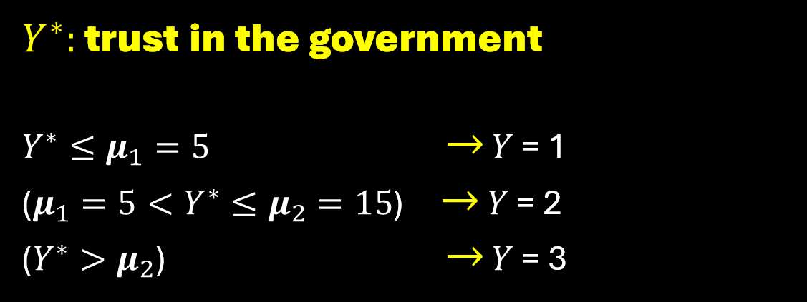
Ordinal regression
$Y^{∗}:$ trust in the government
$Y^{∗}≤μ_{1}=5$ $→$ $Y$ = 1
($μ_{1}=5<Y^{∗}≤μ_{2}=15$) $→$ $Y$ = 2
($Y^{∗}>μ_{2}$) $→$ $Y$ = 3

Slide 7

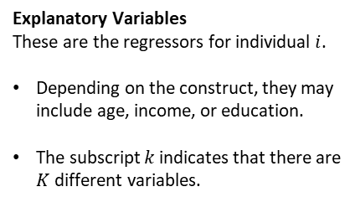
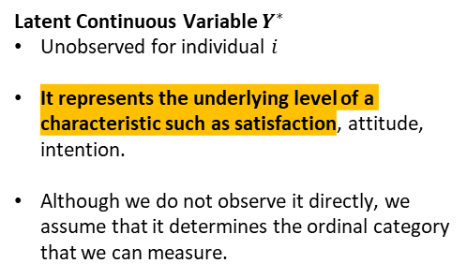
28/05/2026
Ordinal regression
Given the continuous latent variable $Y^{∗}$
These quantify the effect of each explanatory variable $X_{\left\{ki\right\}}$in the latent variable $Y_{i}^{∗}.$
Linear Predictor
This is the systematic part of the model, without the random component.
Latent Continuous Variable $Y^{∗}$
Unobserved for individual $i$
It represents the underlying level of a characteristic such as satisfaction, attitude, intention.
Although we do not observe it directly, we assume that it determines the ordinal category that we can measure.
Explanatory Variables
These are the regressors for individual $i$.
Depending on the construct, they may include age, income, or education.
The subscript $k$ indicates that there are $K$ different variables.
Error Term / Random Disturbance
This captures unobserved factors or measurement errors.
In ordered logit models, the error term is assumed to follow a standard logistic distribution with mean 0 and variance ≈ 3.29.
In ordered probit models, it follows a standard normal distribution, N(0,1).

Slide 8
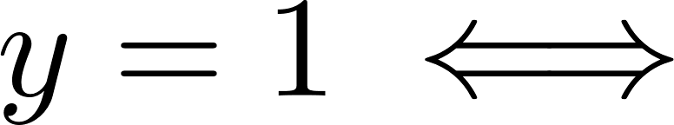

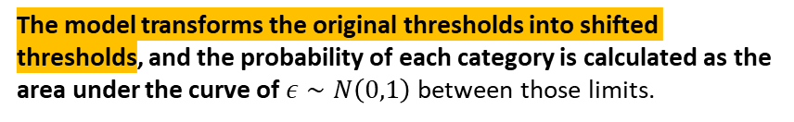
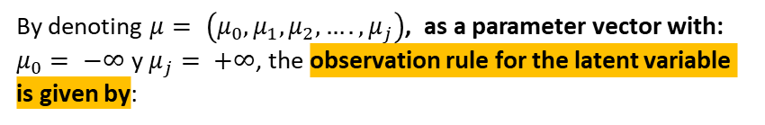


28/05/2026
Ordinal regression
By denoting $μ= \left(μ_{0}, μ_{1}, μ_{2}, …., μ_{j}\right)$, as a parameter vector with: $μ_{0}= −∞$ y $μ_{j}= +∞$, the observation rule for the latent variable is given by:
The decision regarding the value that y takes is therefore reduced to determining where the error term ε falls with respect to the thresholds adjusted by the linear predictor.
The model transforms the original thresholds into shifted thresholds, and the probability of each category is calculated as the area under the curve of $ε∼N\left(0,1\right)$ between those limits.
Taking $y=1$, and subtracting $α$ from both sides of the inequality we get:
Then we can define $F$ as the cumulative density function of $ε$, for a given $j$ value of $y$.
Thus the observation rule does not depend on e, $μ_{0}, μ_{1}$ or on $α$, but rather on: ${ (μ}_{0}−α)$ y $(μ_{1} −α)$

Slide 9
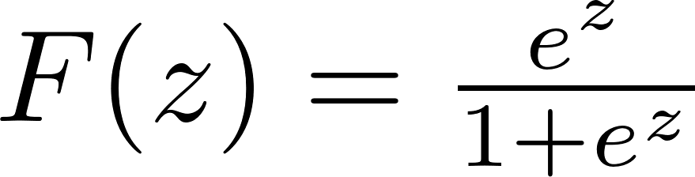
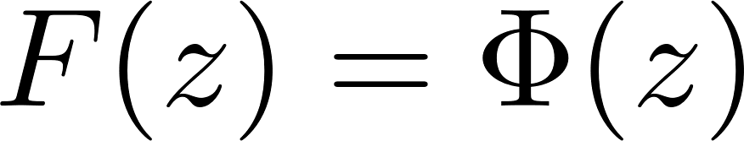
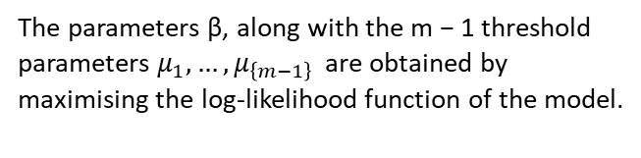
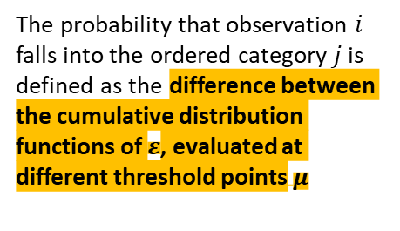
28/05/2026
Ordinal regression
The probability that observation $i$ falls into the ordered category $j$ is defined as the difference between the cumulative distribution functions of $ε$, evaluated at different threshold points$μ$
Cumulative distribution functions of ε, evaluated at different threshold points μ, the covariates x, and the parameters β.
The parameters β, along with the m − 1 threshold parameters $μ_{1}, …,μ_{\left\{m−1\right\}}$ are obtained by maximising the log‑likelihood function of the model.
In the ordered logit model, the error term ε follows a logistic distribution.
In the ordered probit model, the error term ε follows a standard normal distribution, and F corresponds to the CDF of that normal distribution

Slide 10
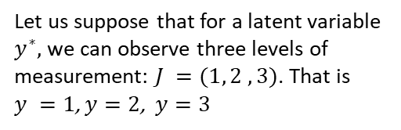

28/05/2026
Ordinal regression
Let us suppose that for a latent variable $y^{∗},$we can observe three levels of measurement: $J =(1, 2 ,3)$. That is $y =1$, $y=2$, $y=3$
$$ε$$

Slide 11
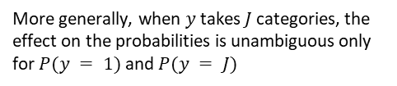
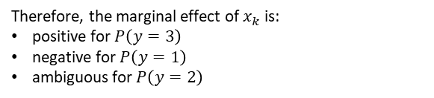
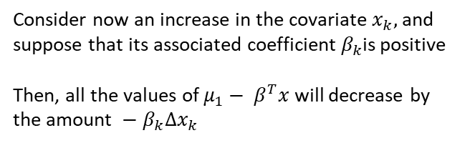
28/05/2026
Ordinal regression
Consider now an increase in the covariate $x_{k},$ and suppose that its associated coefficient $β_{k}$is positive
Then, all the values of $μ_{1}− β^{T}x$ will decrease by the amount $− β_{k}Δx_{k}$
The shaded area with dots represents the increase in the probability that the variable takes the value y=3, and the reduction in the probability of y=2.
The shaded area with lines represents the increase in the probability that the variable takes the value y=2, and the reduction in the probability of y=1.
Therefore, the marginal effect of $x_{k}$​ is:
positive for $P\left(y=3\right)$
negative for $P\left(y=1\right)$
ambiguous for $P\left(y=2\right)$
More generally, when $y$ takes $J$ categories, the effect on the probabilities is unambiguous only for $P(y = 1)$and $P(y = J)$
$$ε$$

Slide 12



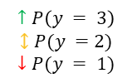
28/05/2026
Ordinal regression
Consider now an increase in the covariate $x_{k},$ and suppose that its associated coefficient $β_{k}$is positive
Then, all the values of $μ_{1}− β^{T}x$ will decrease by the amount $− β_{k}Δx_{k}$
$$↑P\left(y = 3\right)$$
$$↕P(y =2)$$
$$↓P(y = 1)$$
$$− β_{k}Δx_{k}$$
$$ε$$
$$ε$$

Slide 13
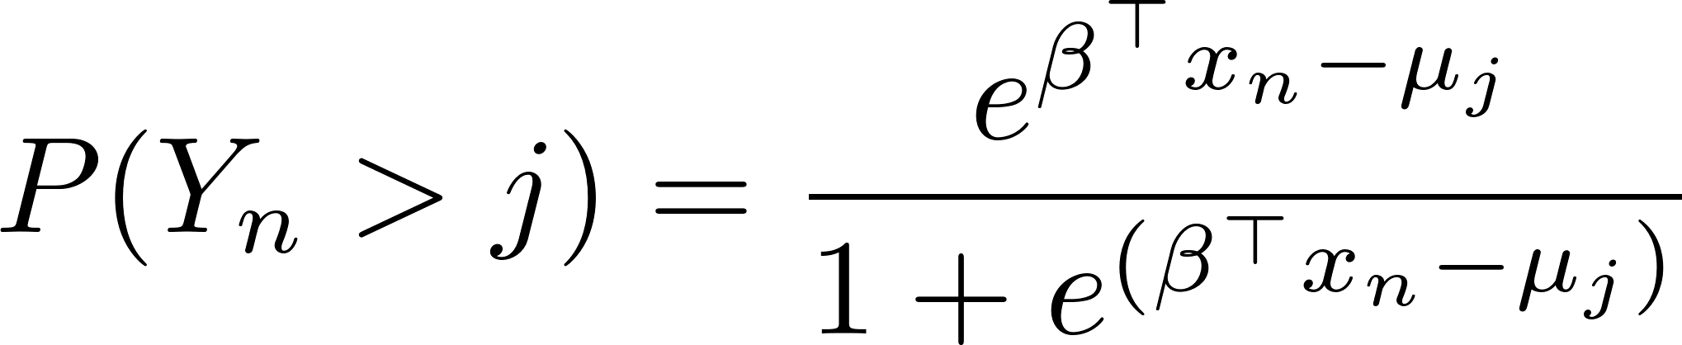
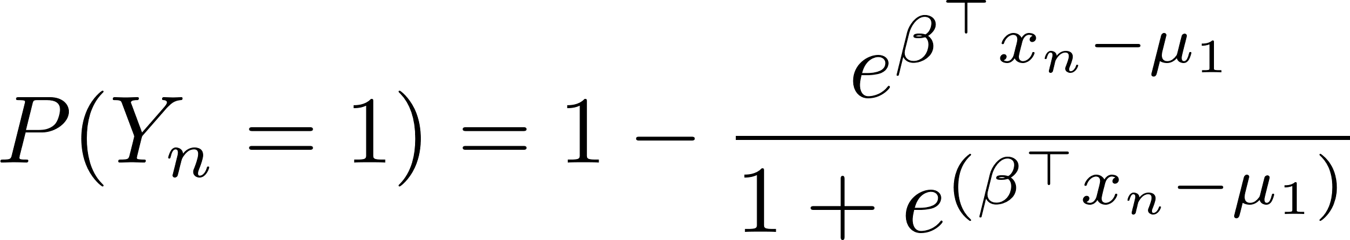
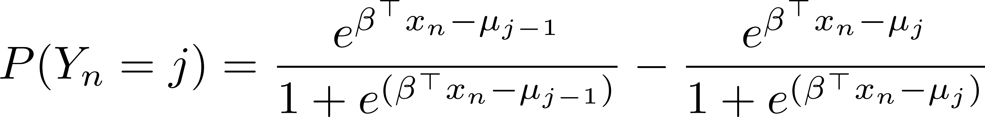
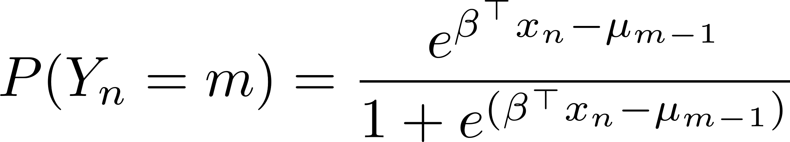
28/05/2026
Ordinal regression
Logistic link
The probability that observation i falls into a category higher than j
Probability that observation i falls into category j = 1.
Probability that observation i falls into category j .
Probability that observation i falls into category m.

Slide 14
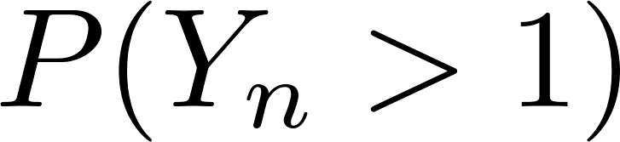

28/05/2026
Ordinal regression
Probability that observation i falls into category j = 1.
$$ε$$
$$j=1$$

Slide 15
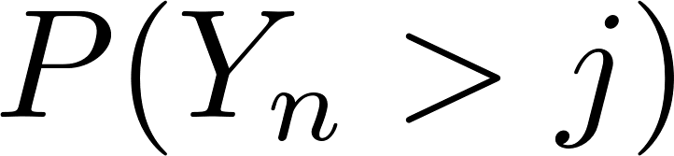


28/05/2026
Ordinal regression
Probability that observation i falls into category j .
$$ε$$
$$j−1$$
$$j$$

Slide 16
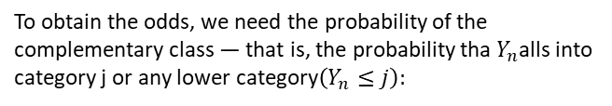
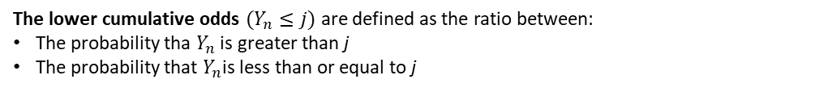
28/05/2026
Ordinal regression
The specification of the ordinal logistic model is
The lower cumulative odds $(Y_{n}≤j)$are defined as the ratio between:
The probability tha $Y_{n}$ is greater than j
The probability that $Y_{n}$is less than or equal to j
To obtain the odds, we need the probability of the complementary class — that is, the probability tha $Y_{n}$alls into category j or any lower category$\left(Y_{n}≤j\right):$
Substituting:
Substituting:
By applying the natural logarithm to both sides of the equation, we obtain the log‑odds:
This is the standard form of the Ordinal Logistic Model with Proportional Odds, using the lower cumulative logit specification.

Slide 17

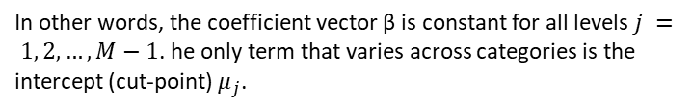
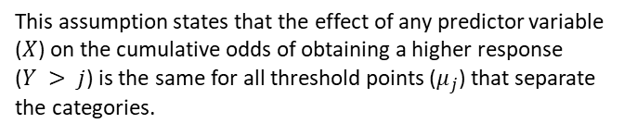
28/05/2026
Ordinal regression
Assumption of Proportional Odds
Visualizing the Proportional Odds Assumption
This assumption states that the effect of any predictor variable ($X$) on the cumulative odds of obtaining a higher response ($Y > j$) is the same for all threshold points ($μ_{j}$) that separate the categories.
$$ln⁡[ (P \left(Y≤j\right)) / (P \left(Y >j\right))$$
In other words, the coefficient vector β is constant for all levels $j = 1, 2, …, M−1$. he only term that varies across categories is the intercept (cut‑point) $μ_{j}$.
$$X$$
Umbral
$$μ1 \left(P \left( Y ≤1\right)\right)$$
𝝁2 (𝑷 ( 𝒀 ≤2))

Slide 18
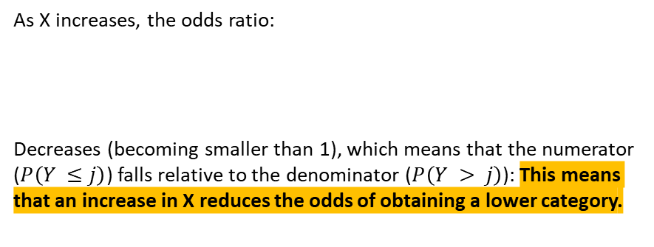
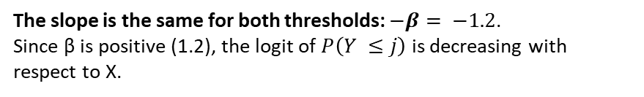
28/05/2026
Ordinal regression
Assumption of Proportional Odds
Visualizing the Proportional Odds Assumption
The slope is the same for both thresholds: $−β= −1.2$.
Since β is positive (1.2), the logit of $P\left(Y ≤j\right)$ is decreasing with respect to X.
An increase in the predictor X (for example, higher GPA) shifts the probabilities towards higher categories, and this happens for both thresholds shown.
$$ln⁡[ (P \left(Y≤j\right)) / (P \left(Y >j\right))$$
As X increases, the odds ratio:
Decreases (becoming smaller than 1), which means that the numerator ($P\left(Y ≤j\right)$) falls relative to the denominator ($P\left(Y > j\right)$): This means that an increase in X reduces the odds of obtaining a lower category.
$$X$$
Umbral
$$μ1 \left(P \left( Y ≤1\right)\right)$$
𝝁2 (𝑷 ( 𝒀 ≤2))

Slide 19
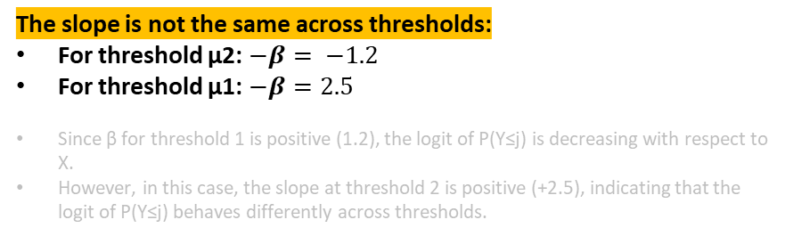
28/05/2026
Ordinal regression
Assumption of Proportional Odds
The slope is not the same across thresholds:
For threshold μ2: $−β= −1.2$
For threshold μ1: $−β=2.5$
Since β for threshold 1 is positive (1.2), the logit of P(Y≤j) is decreasing with respect to X.
However, in this case, the slope at threshold 2 is positive (+2.5), indicating that the logit of P(Y≤j) behaves differently across thresholds.
Visualizing the Proportional Odds Assumption
In this situation, the ordered logit model is not suitable for studying the dependent variable, because the model estimates a single coefficient β for all cut‑points.
If the true slopes differ, the single estimated slope becomes an average that fits poorly at the extremes of the ordinal scale.
When this happens, one must make decisions about the model's application:
$$ln⁡[ (P \left(Y≤j\right)) / (P \left(Y >j\right))$$
Re‑categorise the variable, if theoretically justified, and fit a new ordered logit model, or a binary logit based on the new categorisation.
If theoretically justified, fit a multinomial logit model.
$$X$$
Fit a partial proportional odds logit model, which relaxes the proportional‑odds assumption.
Umbral
$$μ1 \left(P \left( Y ≤1\right)\right)$$
𝝁2 (𝑷 ( 𝒀 ≤2))
Notes:
La pendiente, en ambos umbrales no es la misma: $−β= −1.2,$ para el umbral $μ2$, y $−β=2.5$ para el umbral 𝜇1
Dado que es negativa $β$ del umbral 1es positivo (1.2), entonces la función de Logit $P\left(Y ≤j\right)$ es decreciente respecto a $X,$ pero en este caso, la pendiente del umbral 2 es negativa (-2.5), lo que indica que de Logit $P\left(Y ≤j\right)$ es decreciente respecto a $X$. En este contexto el modelo logit ordenado, no es adecuado para estudiar la variable dependiente y se deben tomar decisiones sobre su aplicación:
Recategorizar, si hace sentido teórico, los niveles de la variable ordena y aplicar, un modelo logit ordenado nuevo, o un logit para una recategorización binaria.

Slide 20
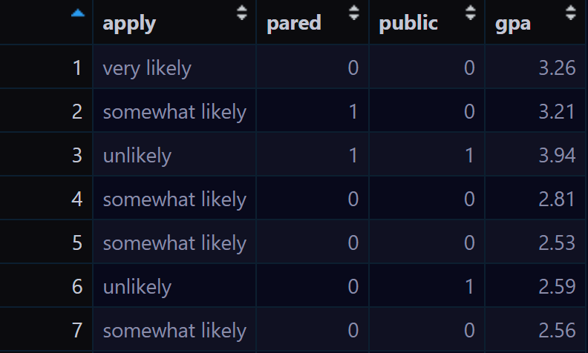
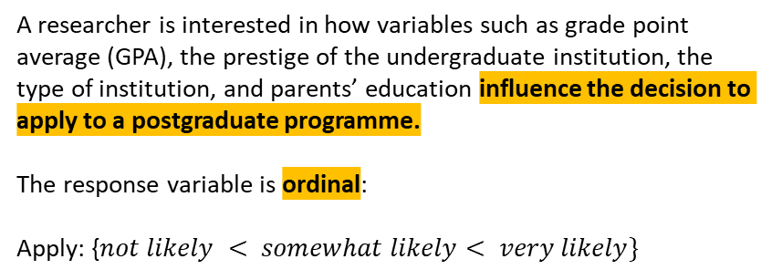
28/05/2026
Ordinal regression
A researcher is interested in how variables such as grade point average (GPA), the prestige of the undergraduate institution, the type of institution, and parents’ education influence the decision to apply to a postgraduate programme.
The response variable is ordinal:
Apply: {$not likely < somewhat likely< very likely\}$
Apply. Decision to apply to a postgraduate programme
Pared. Indicator variable specifying whether the student’s parents hold an undergraduate degree.
Public. Indicator variable denoting whether the student completed their undergraduate studies at a public university.
GPA. Independent numerical variable describing the student’s cumulative academic average (Grade Point Average).
Notes:
No existe una forma cerrada para la función normal. Por eso:
Se deja expresada como una integral.
Su evaluación requiere métodos numéricos o tablas precomputadas.
En modelos probit, se usa esta forma acumulada para mapear el predictor lineal a una probabilidad.
Estas son funciones de distribucion acumulada.

Slide 21
28/05/2026
Ordinal regression
Stratified Boxplot
Relative frequencies table
Public University
Private University
Category | Level | Frequency | R frequency
A. Intention to Apply (apply)
Not likely | 1 | 220 | 55%
Somewhat likely | 2 | 140 | 35%
Very likely | 3 | 40 | 10%
B. Parents’ Higher Education (pared)
No Higher Education | 0 | 337 | 84.25%
With Higher Education | 1 | 63 | 15.75%
C. Type of University (public)
Private | 0 | 343 | 85.75%
Public | 1 | 57 | 14,25%
Pared: No Higher Education
GPA
Pared: Higher Education
Not likely
Somewhat likely
Very likely
Not likely
Somewhat likely
Very likely
Decision to apply to a postgraduate programme
Notes:
No existe una forma cerrada para la función normal. Por eso:
Se deja expresada como una integral.
Su evaluación requiere métodos numéricos o tablas precomputadas.
En modelos probit, se usa esta forma acumulada para mapear el predictor lineal a una probabilidad.
Estas son funciones de distribucion acumulada.

Slide 22
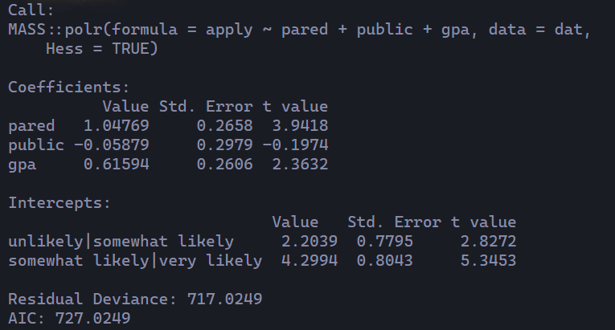
28/05/2026
Ordinal regression
When estimating the model, we obtain:
Regression function used
Dependent variable
Independent variables
Reference to the table containing the variables
Test statistic. Evaluates whether each coefficient differs significantly from zero. To reject the null hypothesis associated with a coefficient, the value of the statistic must exceed the critical value corresponding to the chosen significance level α (1.96 when α = 0.05).
Estimated coefficients of the ordinal logit model. Their scale is in log‑odds, which means they cannot be interpreted in the same way as coefficients from an OLS regression. To interpret them correctly, researchers must:
compute odds ratios, and
evaluate predicted probabilities.
Intercepts (cut‑points) of the model. These are not direct probabilities. Instead, they correspond to the threshold parameters (μₖ) on the latent, underlying continuous scale (Y*), expressed on the logit scale. These cut‑points determine where, along the linear predictor, the cumulative probabilities transition from one category to the next.
Null deviance (model without predictors). Indicates how well (or poorly) the model predicts the response variable when no control variables are included. Higher values imply a poorer fit.
Akaike Information Criterion (AIC). Penalises model complexity. A lower AIC reflects a better balance between goodness‑of‑fit and parsimony.
Notes:
No existe una forma cerrada para la función normal. Por eso:
Se deja expresada como una integral.
Su evaluación requiere métodos numéricos o tablas precomputadas.
En modelos probit, se usa esta forma acumulada para mapear el predictor lineal a una probabilidad.
Estas son funciones de distribucion acumulada.

Slide 23
28/05/2026
Ordinal regression
Estimated Intercepts (Cut‑points)
Not likely
Somewhat likely
Very likely
Ordered variable categories
2.2
4.3
Not likely
Somewhat likely
Very likely
Cumulative probability of selecting a higher category
Notes:
No existe una forma cerrada para la función normal. Por eso:
Se deja expresada como una integral.
Su evaluación requiere métodos numéricos o tablas precomputadas.
En modelos probit, se usa esta forma acumulada para mapear el predictor lineal a una probabilidad.
Estas son funciones de distribucion acumulada.

Slide 24
28/05/2026
Ordinal regression
Estimated Intercepts (Cut‑points)
The estimated cut‑points at 2.2 and 4.3 determine the boundaries separating “not likely” from “somewhat likely”, and “somewhat likely” from “very likely”, respectively.
The categories of the ordinal response variable correspond to intervals on the underlying latent scale. These latent thresholds do not represent direct probabilities; instead, they indicate the points at which the cumulative probability of selecting a higher category crosses specific values.
Not likely
Somewhat likely
Very likely
Ordered variable categories
2.2
4.3
Not likely
Somewhat likely
Very likely
Cumulative probability of selecting a higher category
Notes:
No existe una forma cerrada para la función normal. Por eso:
Se deja expresada como una integral.
Su evaluación requiere métodos numéricos o tablas precomputadas.
En modelos probit, se usa esta forma acumulada para mapear el predictor lineal a una probabilidad.
Estas son funciones de distribucion acumulada.

Slide 25
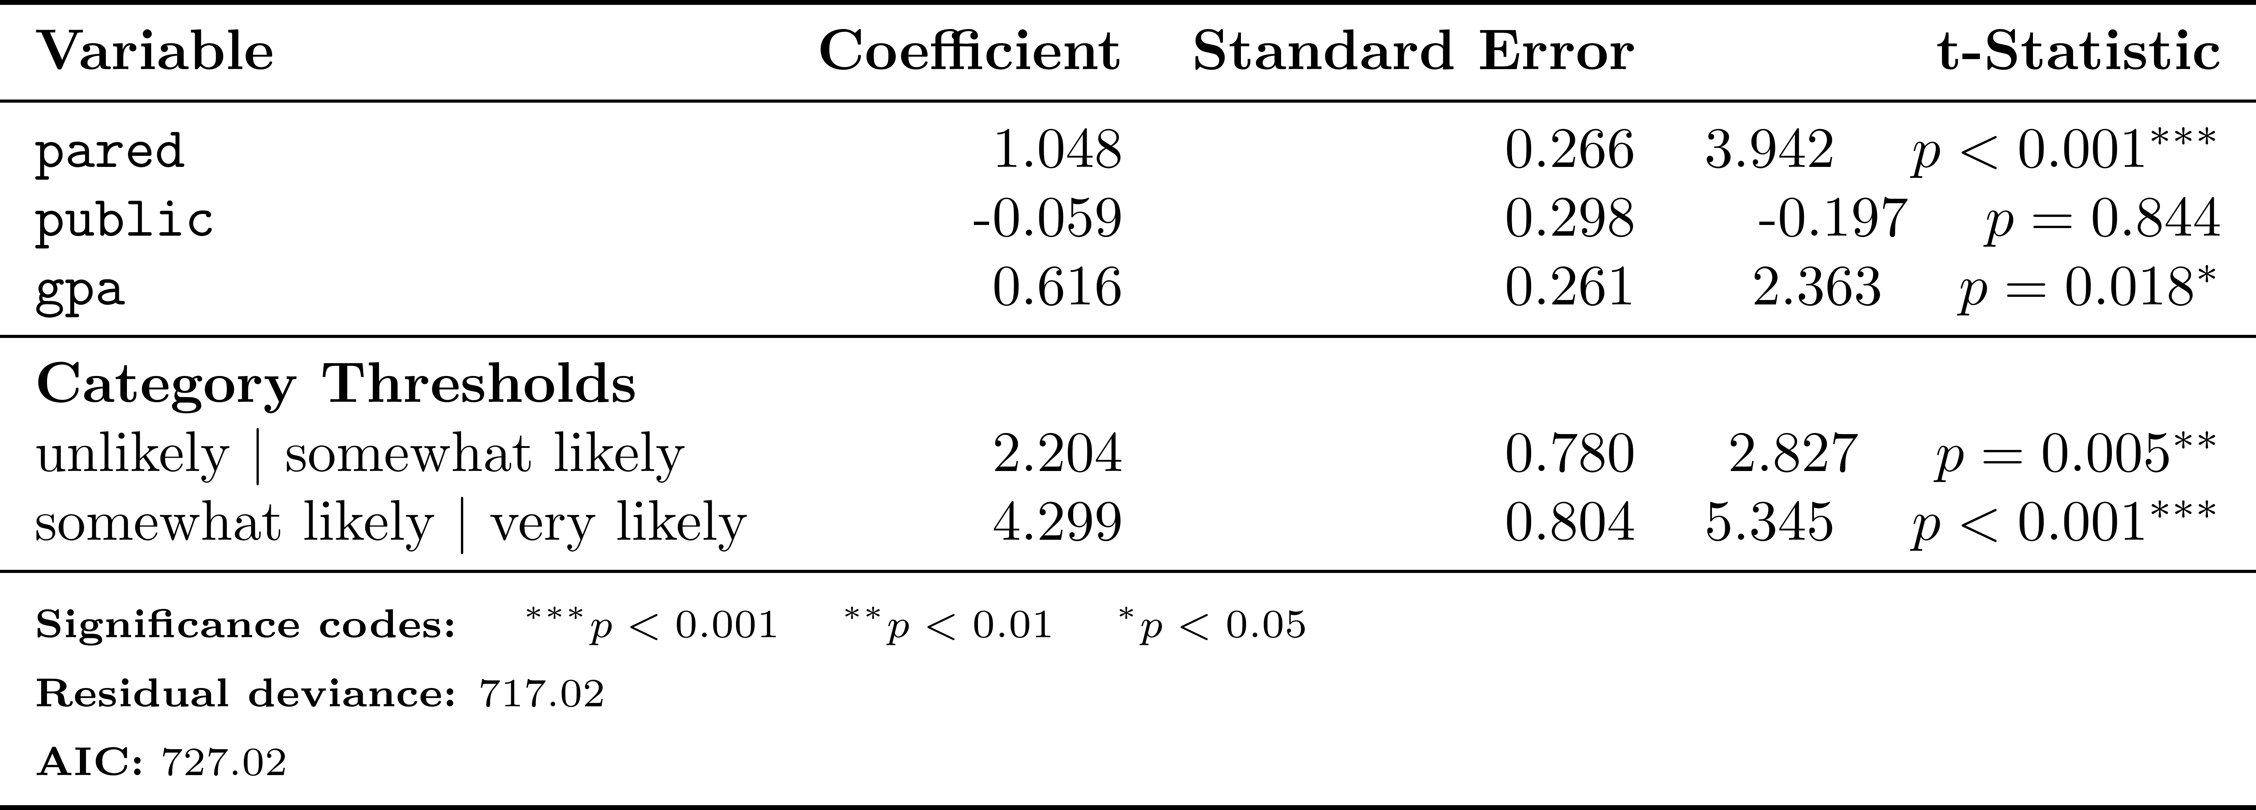
28/05/2026
Ordinal regression
Results of the Ordinal Logistic Regression on the Intention to Apply to a Postgraduate Programme
The estimated model includes threshold (cut‑point) parameters and cumulative probabilities for the lower‑order categories. These cut‑points indicate the values of the latent variable at which the probability of selecting a higher category exceeds that of the adjacent lower category.
To aid interpretation, the exponentiated coefficients (odds ratios) should be computed .These measure the multiplicative change in the cumulative odds of reporting a higher intention to apply, associated with a one‑unit increase in each predictor.
Having parents with higher education. This factor reduces the cumulative log‑odds of being in a lower application‑intention category compared with being in the highest category (“very likely”) by 1.048 units. In substantive terms, students whose parents hold a university degree are more likely to report a higher intention to apply.
Graduating from a public university. Shows a coefficient that is slightly positive (0.059) but statistically insignificant. Therefore, there is no evidence that attending a public university affects the intention to apply to a postgraduate programme.
Grade Point Average (GPA). Each additional point in GPA decreases the cumulative log‑odds of being in a lower category by 0.616 units, indicating that higher academic achievement is associated with higher intention to apply.
Notes:
No existe una forma cerrada para la función normal. Por eso:
Se deja expresada como una integral.
Su evaluación requiere métodos numéricos o tablas precomputadas.
En modelos probit, se usa esta forma acumulada para mapear el predictor lineal a una probabilidad.
Estas son funciones de distribucion acumulada.

Slide 26
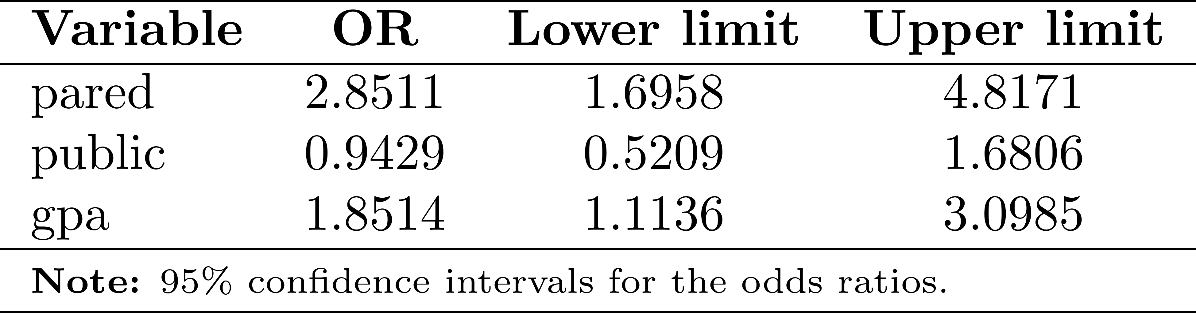
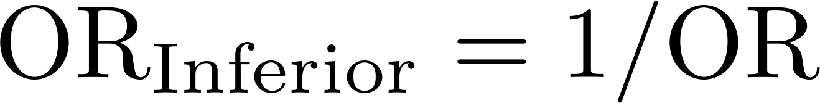
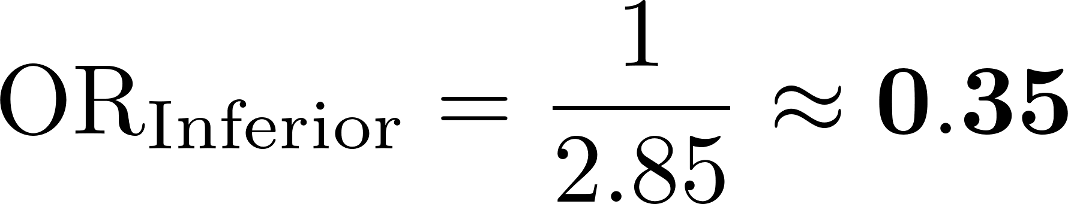
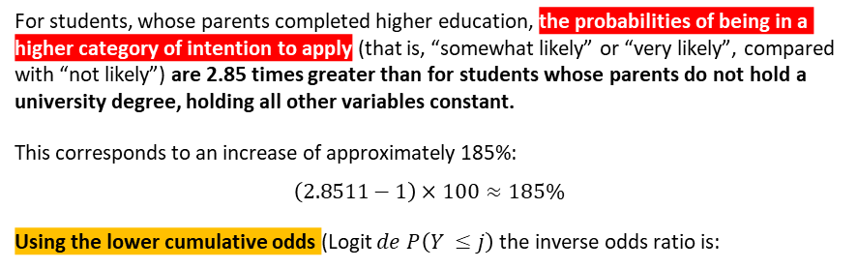
28/05/2026
Ordinal regression
Results of the Ordinal Logistic Regression Regarding the Intention to Apply to Postgraduate Studies
Parental education
For students, whose parents completed higher education, the probabilities of being in a higher category of intention to apply (that is, “somewhat likely” or “very likely”, compared with “not likely”) are 2.85 times greater than for students whose parents do not hold a university degree, holding all other variables constant.
This corresponds to an increase of approximately 185%:
$$\left(2.8511−1\right)×100≈185\%$$
Using the lower cumulative odds (Logit $de P\left(Y ≤j\right)$the inverse odds ratio is:
To interpret the results, we may (and should) also apply the exponential function to the estimated parameters to obtain the odds ratios (ORs):
Thus, the lower cumulative odds (“not likely” vs “somewhat or very likely”) are 65% lower for students whose parents have higher education:
$$\left(1−0.35\right)×100≈65\%$$
For students whose parents did attend university, the probabilities of being in a lower category of intention to apply are 65% lower than for students whose parents do not have higher education.
Notes:
(*) Para los estudiantes de instituciones privadas, las probabilidades de estar en una categoría más alta de intención de aplicar son 1.06 veces mayores (es decir, 1 / 0.943) que las de los estudiantes de instituciones públicas, manteniendo constantes las demás variables. Para los estudiantes de instituciones privadas, las probabilidades de estar en una categoría más baja de intención de aplicar son 5.71 % menores que las de los estudiantes de instituciones públicas, manteniendo constantes las demás variables. Para los estudiantes de instituciones públicas, las probabilidades de estar en una categoría más baja son 1.06 veces mayores que las de los estudiantes de instituciones privadas, manteniendo constantes las demás variables.
Promedio académico (GPA)
(*) Por cada unidad adicional en el GPA del estudiante, las probabilidades de estar en una categoría más alta de intención de aplicar (es decir, “muy probable” o “algo probable” frente a “poco probable”) se multiplican por 1.85 (es decir, aumentan en un 85 %), manteniendo constantes las demás variables. Por cada unidad menos en el GPA del estudiante, las probabilidades de estar en una categoría más baja (es decir, “poco probable” frente a “algo probable” o “muy probable”) se multiplican por 1.85, manteniendo constantes las demás variables.

Slide 27
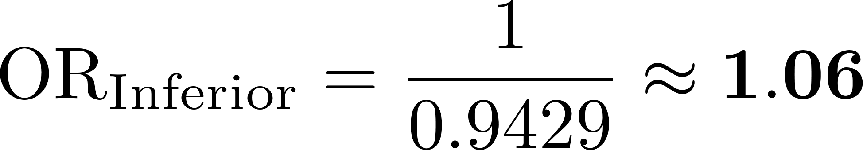
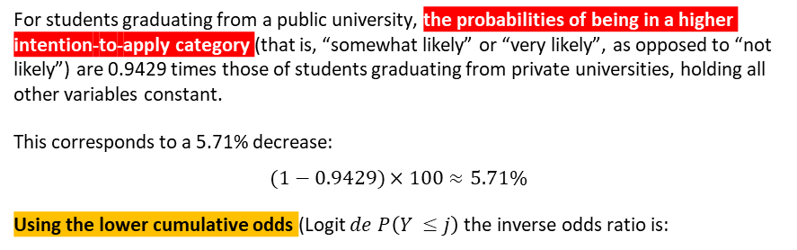
28/05/2026
Ordinal regression
Results of the Ordinal Logistic Regression Regarding the Intention to Apply to Postgraduate Studies
Type of University
For students graduating from a public university, the probabilities of being in a higher intention‑to‑apply category (that is, “somewhat likely” or “very likely”, as opposed to “not likely”) are 0.9429 times those of students graduating from private universities, holding all other variables constant.
This corresponds to a 5.71% decrease:
$$(1−0.9429)×100≈5.71\%$$
Using the lower cumulative odds (Logit $de P\left(Y ≤j\right)$the inverse odds ratio is:
To interpret the results, we may (and should) also apply the exponential function to the estimated parameters to obtain the odds ratios (ORs):
Thus, the lower cumulative odds (“not likely” vs. “somewhat or very likely”) are 6% higher for students graduating from public universities.
$$\left(1.06 −1\right)×100≈6\%$$
For students who graduated from a public university, the probabilities of being in a lower category of intention to apply are 6% higher than those of students who graduated from private universities.
Notes:
(*) Para los estudiantes de instituciones privadas, las probabilidades de estar en una categoría más alta de intención de aplicar son 1.06 veces mayores (es decir, 1 / 0.943) que las de los estudiantes de instituciones públicas, manteniendo constantes las demás variables. Para los estudiantes de instituciones privadas, las probabilidades de estar en una categoría más baja de intención de aplicar son 5.71 % menores que las de los estudiantes de instituciones públicas, manteniendo constantes las demás variables. Para los estudiantes de instituciones públicas, las probabilidades de estar en una categoría más baja son 1.06 veces mayores que las de los estudiantes de instituciones privadas, manteniendo constantes las demás variables.
Promedio académico (GPA)
(*) Por cada unidad adicional en el GPA del estudiante, las probabilidades de estar en una categoría más alta de intención de aplicar (es decir, “muy probable” o “algo probable” frente a “poco probable”) se multiplican por 1.85 (es decir, aumentan en un 85 %), manteniendo constantes las demás variables. Por cada unidad menos en el GPA del estudiante, las probabilidades de estar en una categoría más baja (es decir, “poco probable” frente a “algo probable” o “muy probable”) se multiplican por 1.85, manteniendo constantes las demás variables.

Slide 28
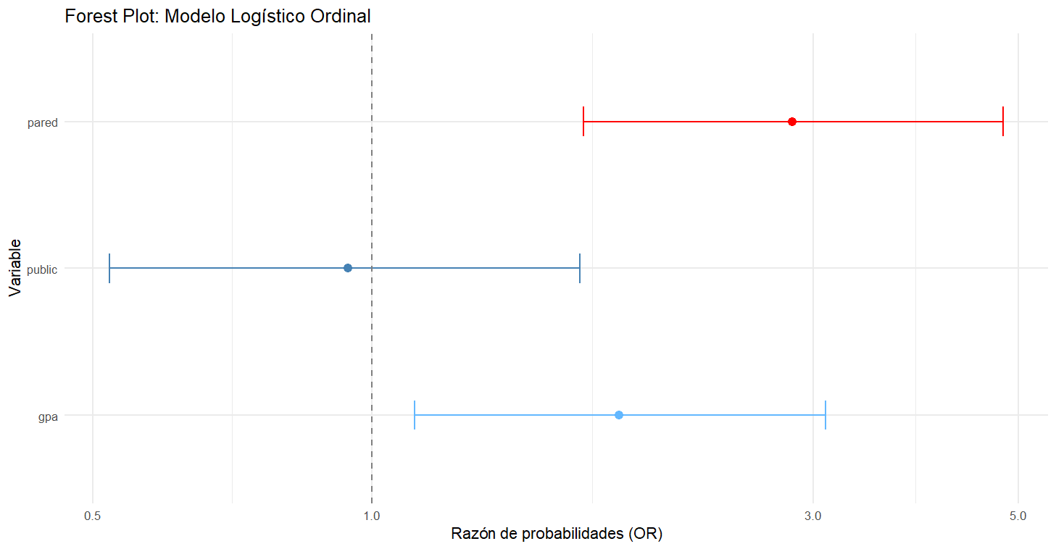
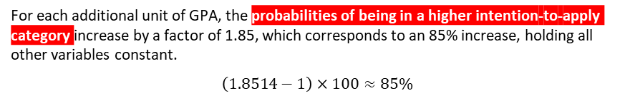
28/05/2026
Ordinal regression
Results of the Ordinal Logistic Regression Regarding the Intention to Apply to Postgraduate Studies
GPA
For each additional unit of GPA, the probabilities of being in a higher intention‑to‑apply category increase by a factor of 1.85, which corresponds to an 85% increase, holding all other variables constant.
$$\left(1.8514−1\right)×100≈85\%$$
To interpret the results, we may (and should) also apply the exponential function to the estimated parameters to obtain the odds ratios (ORs):
Forest Plot of the Estimated Parameters in the Ordinal Model
Notes:
(*) Para los estudiantes de instituciones privadas, las probabilidades de estar en una categoría más alta de intención de aplicar son 1.06 veces mayores (es decir, 1 / 0.943) que las de los estudiantes de instituciones públicas, manteniendo constantes las demás variables. Para los estudiantes de instituciones privadas, las probabilidades de estar en una categoría más baja de intención de aplicar son 5.71 % menores que las de los estudiantes de instituciones públicas, manteniendo constantes las demás variables. Para los estudiantes de instituciones públicas, las probabilidades de estar en una categoría más baja son 1.06 veces mayores que las de los estudiantes de instituciones privadas, manteniendo constantes las demás variables.
Promedio académico (GPA)
(*) Por cada unidad adicional en el GPA del estudiante, las probabilidades de estar en una categoría más alta de intención de aplicar (es decir, “muy probable” o “algo probable” frente a “poco probable”) se multiplican por 1.85 (es decir, aumentan en un 85 %), manteniendo constantes las demás variables. Por cada unidad menos en el GPA del estudiante, las probabilidades de estar en una categoría más baja (es decir, “poco probable” frente a “algo probable” o “muy probable”) se multiplican por 1.85, manteniendo constantes las demás variables.

Slide 29
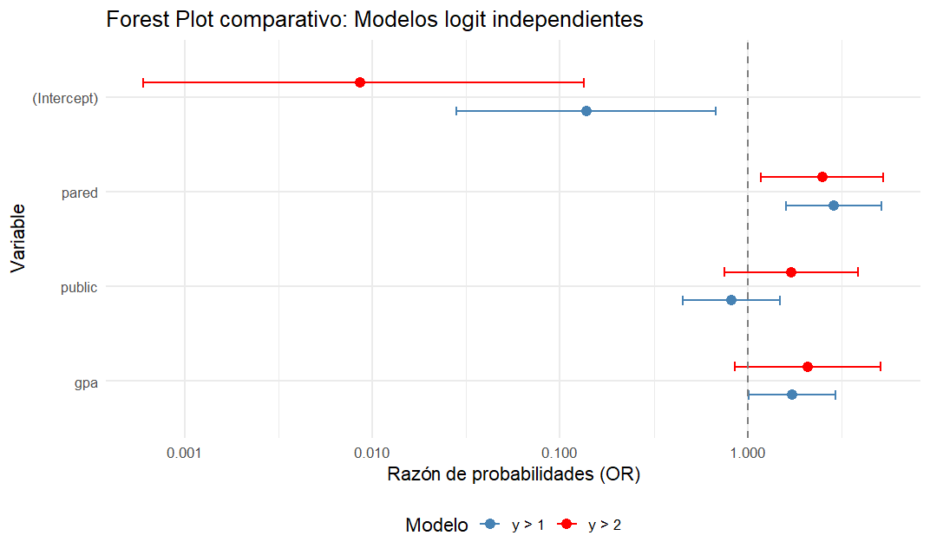
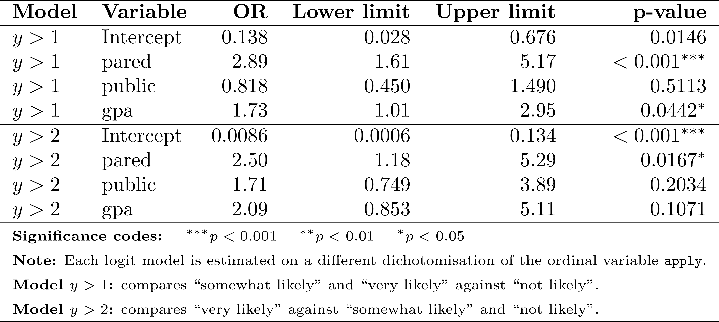
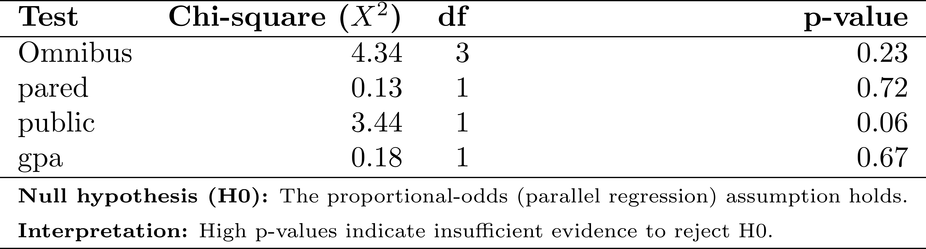
28/05/2026
Ordinal regression
Proportional Odds assumption
To verify whether the effect of any predictor variable (X) on the cumulative odds of obtaining a higher response (Y > j) is the same across all threshold points (μ₁, μ₂, …), we estimate auxiliary binary logit models based on dichotomisations of the ordinal dependent variable:
Forest Plot of the Estimated Parameters in the Auxiliary Logit Models
1
2
Auxiliary logit models
As an additional step, a Brant test may be used to evaluate formally whether the proportional‑odds (parallel‑regression) assumption is satisfied. The test compares the coefficients estimated in the separate binary logit models for each threshold (e.g., Y>1 and Y>2).
Notes:
No existe una forma cerrada para la función normal. Por eso:
Se deja expresada como una integral.
Su evaluación requiere métodos numéricos o tablas precomputadas.
En modelos probit, se usa esta forma acumulada para mapear el predictor lineal a una probabilidad.
Estas son funciones de distribucion acumulada.

Slide 30
28/05/2026
Ordinal regression
The logistic model not only enables the estimation of individual probabilities but also allows the construction of comparative intention‑to‑apply profiles. By holding GPA constant and systematically varying parental education and institution type, it becomes possible to identify specific probability scenarios for belonging to the highest category of intention to apply.
Sebastián
Type of institution: private
Parents: both hold postgraduate degrees
GPA: 3.5
Predicted probability of belonging to the highest intention‑to‑apply category: 73%
Felipe
Type of institution: public
Parents: neither parent holds an undergraduate degree
GPA: 3.5
Predicted probability of belonging to the highest intention‑to‑apply category: 47%
Notes:
No existe una forma cerrada para la función normal. Por eso:
Se deja expresada como una integral.
Su evaluación requiere métodos numéricos o tablas precomputadas.
En modelos probit, se usa esta forma acumulada para mapear el predictor lineal a una probabilidad.
Estas son funciones de distribucion acumulada.

Slide 31
On P-values and statistical significance

Slide 32
28/05/2026
Use of the p-value in hypothesis testing
In a conservative approach, until proven otherwise, the null hypothesis is assumed to be valid. When analyzing a hypothesis test, we want to know:
If you see a p-value of 0.01, this does not mean that there is a 1% probability that the result is due to chance.
The p-value represents the probability of observing the results obtained, or more extreme results, assuming that the null hypothesis is actually true.
What is the probability of obtaining results like those observed in the sample if the null hypothesis were actually true?
This probability is the p-value.
A p-value < 0.05 means that: there is only a 5% or lower probability that a result like the one observed in the sample would occur under the null hypothesis.
If this happens, we should reject the null hypothesis that there is no treatment effect and conclude that, given the available data, the treatment had an effect. In other words, the treatment effect was significantly different from zero.

Slide 33
28/05/2026
Use of the p-value in hypothesis testing
Researchers are interested in whether exposure to online fake news is associated with lower trust in democratic institutions.
Fake news consumption
H0
Null hypothesis
Frequency with which individuals are exposed to or engage with online misinformation (e.g. self-reported exposure, interaction with known misinformation sources).
Fake news consumption has no association with institutional trust.
Ha
Alternative hypothesis
Fake news consumption is associated with institutional trust.
Institutional trust
An index measuring trust in institutions such as parliament, courts, government, or electoral authorities.

Slide 34
28/05/2026
Use of the p-value in hypothesis testing
Researchers are interested in whether exposure to online fake news is associated with lower trust in democratic institutions.
H0
Null hypothesis
Institutional trust $= β₀ + β₁$Fake news consumption+ $X_{i}^{′}γ+ε_{i}$
Fake news consumption has no association with institutional trust.
 | DV: institutional trust
Fake news consumption | −0.315***
Constant | 3.420***
Observations | 1,200
Controls | Yes
R² | 0.28
Robust standard errors in parentheses. *** p < 0.01, ** p < 0.05, * p < 0.10. Controls include age, education, income, and political interest.
Ha
Alternative hypothesis
Fake news consumption is associated with institutional trust.
The estimated coefficient for fake news consumption is negative.
The associated p-value is 0.002.

Slide 35
28/05/2026
Use of the p-value in hypothesis testing
Researchers are interested in whether exposure to online fake news is associated with lower trust in democratic institutions.
H0
Null hypothesis
Institutional trust $= β₀ + β₁$Fake news consumption+ $X_{i}^{′}γ+ε_{i}$
Fake news consumption has no association with institutional trust.
The estimated coefficient for fake news consumption is negative.
The associated p-value is 0.002.
Ha
Alternative hypothesis
If the null hypothesis were true, this would mean that in repeated random samples drawn from the same population, only 2 out of every 1,000 samples would produce an estimated relationship as large as, or larger than, the one observed in out sample.
Because this probability is very small, we reject the null hypothesis and conclude that higher fake news consumption is significantly associated with lower institutional trust.
Fake news consumption is associated with institutional trust.

Slide 36

28/05/2026
Use of the p-value in hypothesis testing
Researchers are interested in whether exposure to online fake news is associated with lower trust in democratic institutions.
H0
Null hypothesis
Institutional trust $= β₀ + β₁$Fake news consumption+ $X_{i}^{′}γ+ε_{i}$
Fake news consumption has no association with institutional trust.
The estimated coefficient for fake news consumption is negative.
The associated p-value is 0.002.
Ha
Alternative hypothesis
If the null hypothesis were true, this would mean that in repeated random samples drawn from the same population, only 2 out of every 1,000 samples would produce an estimated relationship as large as, or larger than, the one observed in out sample.
Because this probability is very small, we reject the null hypothesis and conclude that higher fake news consumption is significantly associated with lower institutional trust.
Fake news consumption is associated with institutional trust.

Slide 37
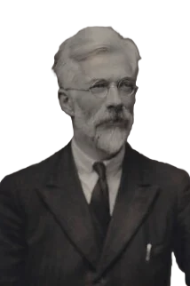
28/05/2026
Why is the p‑value problematic and how can it lead to Type I errors?
We generally use α = 0.05 as the criterion for statistical significance, but this value is arbitrary, and it is important to understand how it came to be used.
Ronald Fisher (1890-1962)
Fisher made numerous fundamental contributions to statistics and developed the concept of significance testing, in which the p‑value is used as a guide to reach a conclusion about a hypothesis.
Fisher viewed the p‑value as a measure of the strength of evidence against the hypothesis: the smaller the p‑value, the stronger the reason to doubt the null hypothesis
Fisher used the term “hypothesis” to refer specifically to the null hypothesis.
How can we evaluate whether an observed result provides genuine evidence against a hypothesis, rather than being a coincidence produced by random variation?
If p < 0.01, he generally regarded the result as clearly significant.
He used 0.05 as a reference point, but for a broader range of p‑values, possibly between 0.01 and 0.20, he often recommended additional experiments to further investigate the observed effect.

Slide 38
28/05/2026
Why is the p‑value problematic and how can it lead to Type I errors?
A person claims to be able to distinguish, purely by taste, whether a cup of tea was prepared by adding milk first and then tea, or adding tea first and then milk.
He did not attempt to prove directly that the person has the ability. Instead, he reframed the problem like :
How likely would this level of performance be if the person had no real ability at all?
Does the person genuinely possess this ability?
Are correct answers simply the result of guessing?
This question lies at the heart of the p‑value concept.
Rather than relying on intuition or authority, Fisher proposes that the claim should be evaluated using a formal experimental procedure.

Slide 39
28/05/2026
Why is the p‑value problematic and how can it lead to Type I errors?
The experiment structure
How likely would this level of performance be if the person had no real ability at all?
Four cups with milk poured first (MF)
A person claims to be able to distinguish, purely by taste, whether a cup of tea was prepared by adding milk first and then tea, or adding tea first and then milk.
Four cups with tea poured first (TF)
H0
Null hypothesis
The person has no ability to distinguish the order in which tea and milk were poured. Any correct classification occurs purely by chance.
Does the person genuinely possess this ability?
Are correct answers simply the result of guessing?
There is no association between how a cup was prepared and how it is identified.
Rather than relying on intuition or authority, Fisher proposes that the claim should be evaluated using a formal experimental procedure.
The person’s responses are equivalent to random guessing.

Slide 40
28/05/2026
Why is the p‑value problematic and how can it lead to Type I errors?
The experiment structure
How likely would this level of performance be if the person had no real ability at all?
Four cups with milk poured first (MF)
H0
Null hypothesis
Four cups with tea poured first (TF)
The person has no ability to distinguish the order in which tea and milk were poured. Any correct classification occurs purely by chance.
Then all 8 cups were ordered randomly
There is no association between how a cup was prepared and how it is identified.
The participant is asked to classify each cup according to how it was prepared. Importantly, the participant knows that there are exactly four cups of each type
The person’s responses are equivalent to random guessing.

Slide 41
28/05/2026
Why is the p‑value problematic and how can it lead to Type I errors?
The experiment structure
How likely would this level of performance be if the person had no real ability at all?
The perfect classification of the tea would look like this:
H0
Null hypothesis
Guess
The person has no ability to distinguish the order in which tea and milk were poured. Any correct classification occurs purely by chance.
4
0
4
Reality
0
4
4
There is no association between how a cup was prepared and how it is identified.
4
4
8
The person’s responses are equivalent to random guessing.
Possible outcomes include:
Four correct classifications (what we would expect on average under random guessing)
Five or six correct classifications (somewhat better than chance)
Seven or eight correct classifications (highly unlikely under chance alone)

Slide 42

28/05/2026
Why is the p‑value problematic and how can it lead to Type I errors?
The experiment structure
How likely would this level of performance be if the person had no real ability at all?
Success number (k) | Permutations of selection | Number of combinations
0 | oooo | 1x1 = 1
1 | ooox, ooxo, oxoo, xooo | 4x4 = 16
2 | ooxx, oxox, oxxo, xoxo, xxoo, xoox | 6x6 = 36
3 | oxxx, xoxx, xxox, xxxo | 4x4 = 16
4 | xxxx | 1x1 = 1
 |  | 70
For a given number of successes k:
Number of combinations= $\left(\begin{matrix}4 \\ k\end{matrix}\right)\left(\begin{matrix}4 \\ 4−k\end{matrix}\right)$
H0
Null hypothesis
The person has no ability to distinguish the order in which tea and milk were poured. Any correct classification occurs purely by chance.
Ways to choose which true items are of one type. which cups are actually milk‑first
Ways to choose which items are guessed as that type. which cups are guessed to be milk‑first.
There is no association between how a cup was prepared and how it is identified.
If k guesses align with the true milk‑first cups, the remaining 4−k guesses must be wrong
The person’s responses are equivalent to random guessing.
Correct guess (x)
Incorrect guesses (o)
The correct guess can appear in any position
There are 4 items of one type and 4 of the other type
Under the null hypothesis, true assignments and guesses are independent

Slide 43



28/05/2026
Why is the p‑value problematic and how can it lead to Type I errors?
The experiment structure
Success number (k) | Permutations of selection | Number of combinations
0 | oooo | 1x1 = 1
1 | ooox, ooxo, oxoo, xooo | 4x4 = 16
2 | ooxx, oxox, oxxo, xoxo, xxoo, xoox | 6x6 = 36
3 | oxxx, xoxx, xxox, xxxo | 4x4 = 16
4 | xxxx | 1x1 = 1
 |  | 70
Let's see what happens when K=1 success
Number of combinations= $\left(\begin{matrix}4 \\ 1\end{matrix}\right)\left(\begin{matrix}4 \\ 4−1\end{matrix}\right)$
Choose which 1 of the 4 true milk‑first cups will be correctly identified
Choose which 3 of the 4 tea‑first cups will be incorrectly guessed as milk‑first
Number of combinations= $\left(\begin{matrix}4 \\ 1\end{matrix}\right)\left(\begin{matrix}4 \\ 4−1\end{matrix}\right)$ = 4x4 = 16
Correct guess (x)
Incorrect guesses (o)
The correct guess can appear in any position
There are 4 items of one type and 4 of the other type
Under the null hypothesis, true assignments and guesses are independent
Once we have:
The total number of permutations
The Number of permutations at least as extreme as the observed result
We can compute:
$$p−value=\frac{\text{extreme} \text{permutations}}{\text{all} \text{permutations}}$$

Slide 44
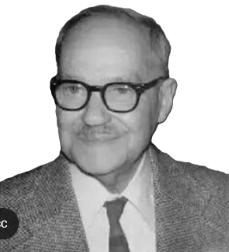
28/05/2026
Why is the p‑value problematic and how can it lead to Type I errors?
Neyman and Pearson suggested that a p‑value < 0.05 implies that the data provide sufficient evidence to reject the null hypothesis and conclude that an effect is statistically significant.
Jerzy Neyman (1894-1981)
⚠️ However, the use of the Neyman–Pearson significance criterion with α = 0.05 can be problematic and carries a high probability of producing Type I errors, unless certain conditions are met when designing the study and analysing the data:
The sample size must be determined in advance.
The hypotheses and the analysis used to test them must be defined beforehand.
Potential control variables must be identified prior to the analysis.
Criteria for excluding participants and handling missing data must be specified in advance.
For exploratory analyses (that is, analyses that are not hypothesis‑testing), a more stringent significance criterion should be used.

Slide 45
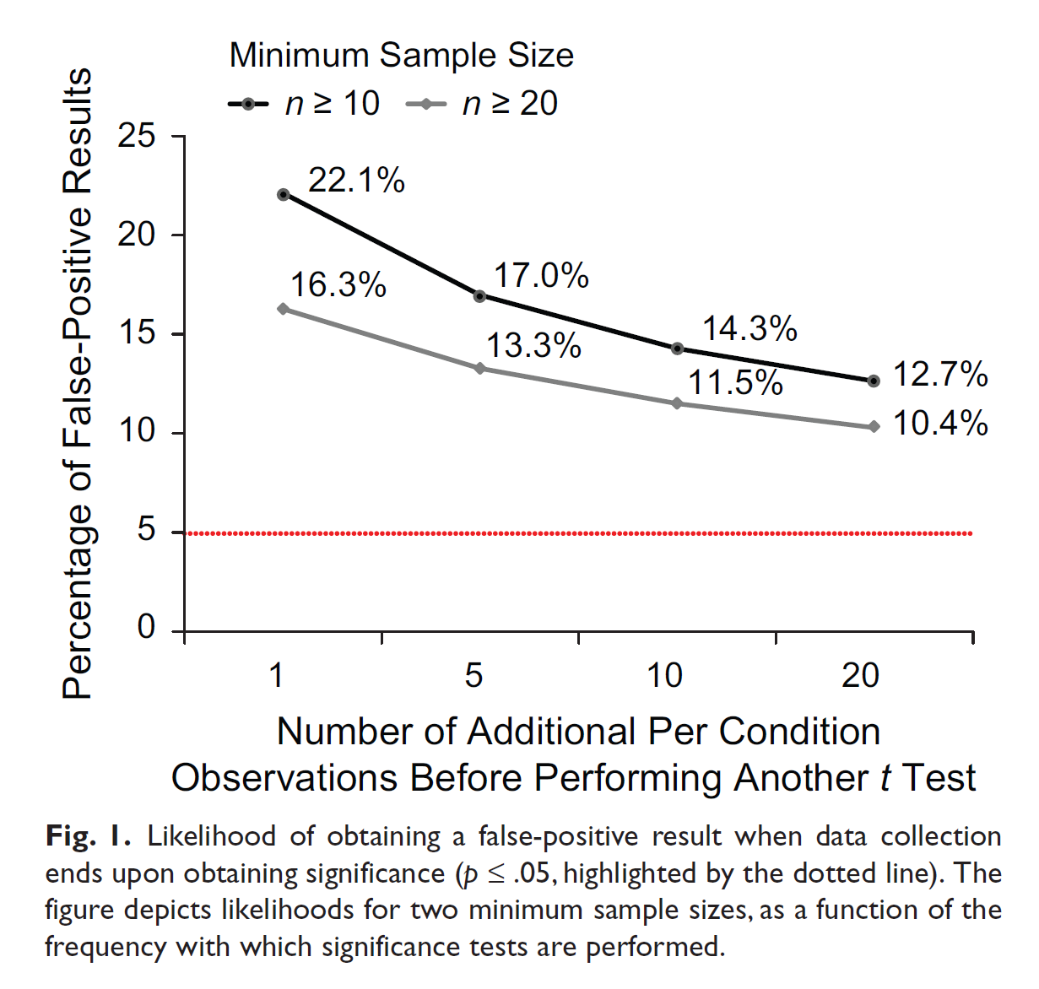
28/05/2026
What happens when the sample size is not determined in advance?
According to Simmons et al. (2011), failing to decide the sample size (or the rule for stopping data collection) before starting the study is an example of “researcher degrees of freedom”.
This practice, which involves collecting data based on preliminary analyses, can dramatically increase the actual false‑positive rate beyond the nominal 5% threshold (p ≤ 0.05).
For example, a researcher who begins with 10 observations per condition and tests for significance after adding each new observation finds a significant effect in 22% of cases.
This demonstrates that flexibility in choosing the sample size, especially stopping data collection once significance is reached, can unacceptably facilitate the publication of “statistically significant” evidence for a false hypothesis.
Simmons, J. P., Nelson, L. D., & Simonsohn, U. (2011). False-Positive Psychology: Undisclosed Flexibility in Data Collection and Analysis Allows Presenting Anything as Significant. Psychological Science, 22(11), 1359–1366. https://doi.org/10.1177/0956797611417632

Slide 46
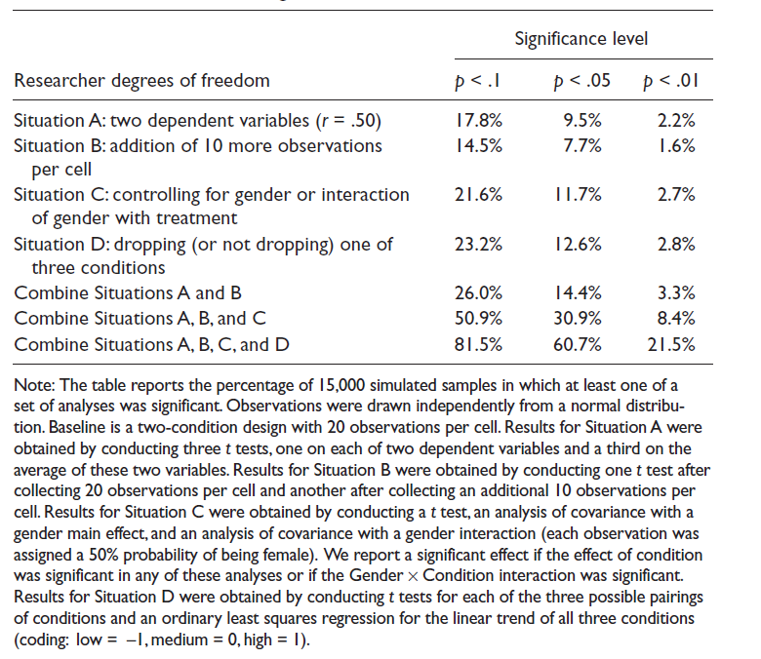
28/05/2026
P‑hacking
The table on the right is based on a computational simulation of an experiment that investigated the impact of an independent variable X, which consists of two conditions (20 participants per condition), on two dependent variables (Y and Z).
Situation A: shows the probability of obtaining false positives (for different significance levels) when researchers test the effect of X on both dependent variables, but report the result for only one analysis.
Situation B: indicates the probability of obtaining false positives if researchers add 10 additional observations per condition after initially non‑significant results.
Situation C: reflects the probability of obtaining false positives when researchers include a control variable, such as gender, in the analysis.
Situation D: shows the probability of obtaining false positives if researchers divide the independent variable into three conditions (for example, low, medium, and high) and then report results for only two of them.
Simmons, J. P., Nelson, L. D., & Simonsohn, U. (2011). False-Positive Psychology: Undisclosed Flexibility in Data Collection and Analysis Allows Presenting Anything as Significant. Psychological Science, 22(11), 1359–1366. https://doi.org/10.1177/0956797611417632

Slide 47
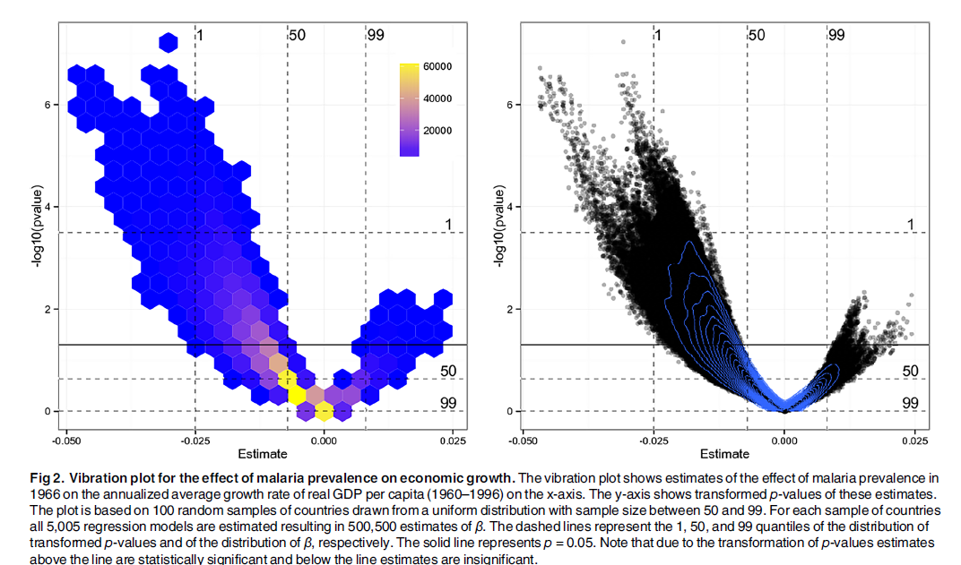
28/05/2026
P‑hacking
P‑hacking is defined as the selection of statistically significant estimates for publication within a study.
P‑hacking occurs when researchers use flexibility in data collection and analysis to find and report results that meet the conventional threshold for statistical significance (p ≤ 0.05).
Common p‑hacking practices
Modifying the set of control variables can influence the estimation of the effect of interest, allowing researchers to select specifications that generate statistically significant results. This practice is also known as multiple model specification, data exploration, or data mining.
Omitting relevant variables (omitted‑variable bias) .
This type of p‑hacking can generate statistical patterns that resemble real effects, making it difficult to distinguish between a genuine effect and a false positive caused by b
Bruns, S. B., & Ioannidis, J. P. A. (2016). P-Curve and p-Hacking in Observational Research. PLoS ONE, 11(2), e0149144. https://doi.org/10.1371/journal.pone.0149144

